Slide 1
Web development basics
JS basics

Slide 2
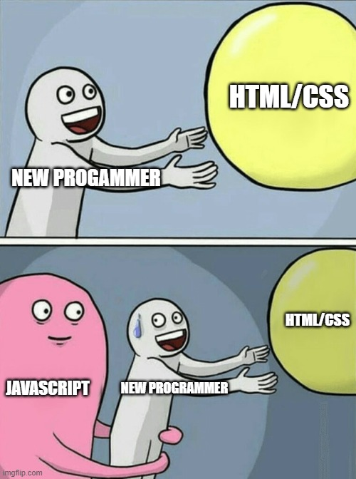
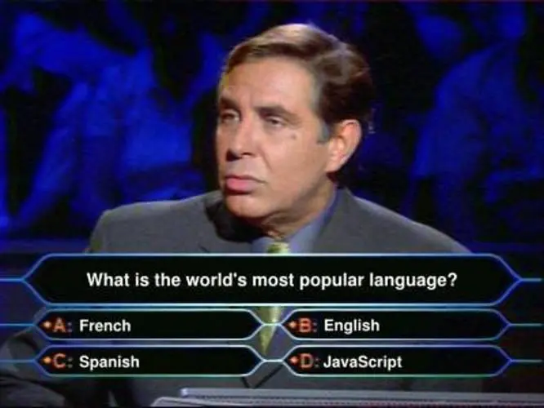
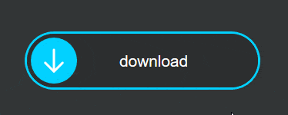
Introduction to JavaScript
JavaScript is a programming language that allows you to add interactivity and dynamic behavior to websites. It can be used to create things like responsive navigation menus, image sliders, and form validation. It runs in the user's browser, allowing you to make web pages dynamic and interactive without having to refresh the page.

Slide 3
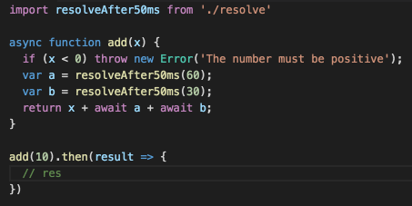
Syntax and language structure
JavaScript is a high-level, interpreted language. It uses a C-style syntax, which means that it uses curly braces, semi-colons, and similar structure. It is also an object-oriented language, which means that it is based on the concept of objects, which have properties and methods.

Slide 4
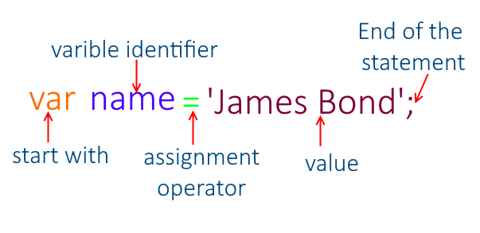
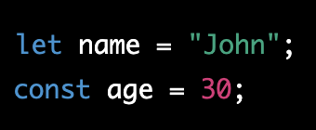
Variables in JavaScript
A JavaScript program typically starts with a declaration of variables, which are used to store data. Variables are declared using the keyword "var", "let" or "const" followed by the variable name and an assignment operator (=) to assign a value.

Slide 5
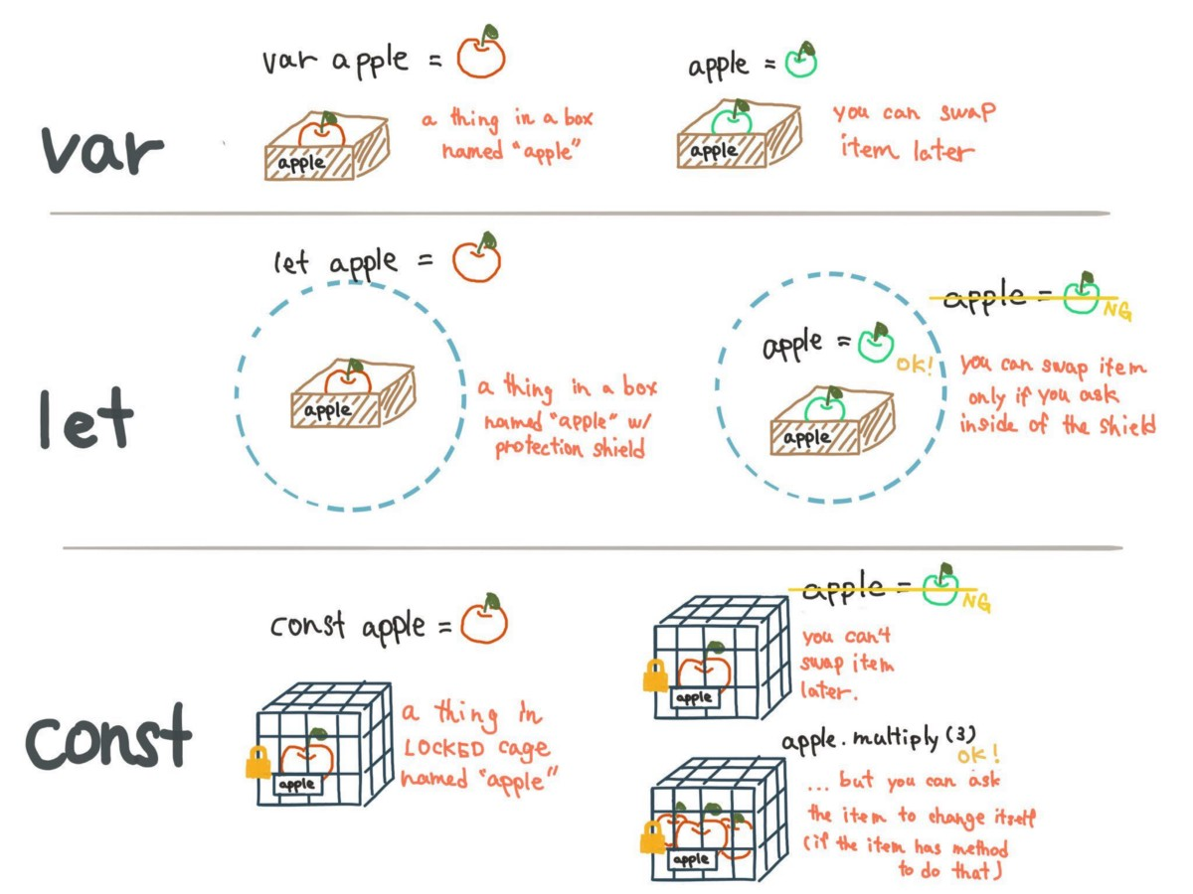
Variables in JavaScript 2

Slide 6
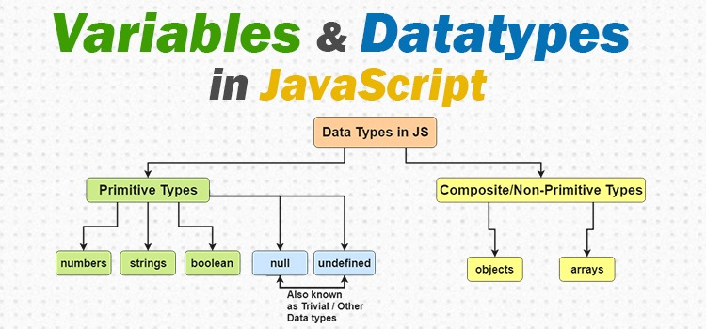
Datatypes

Slide 7
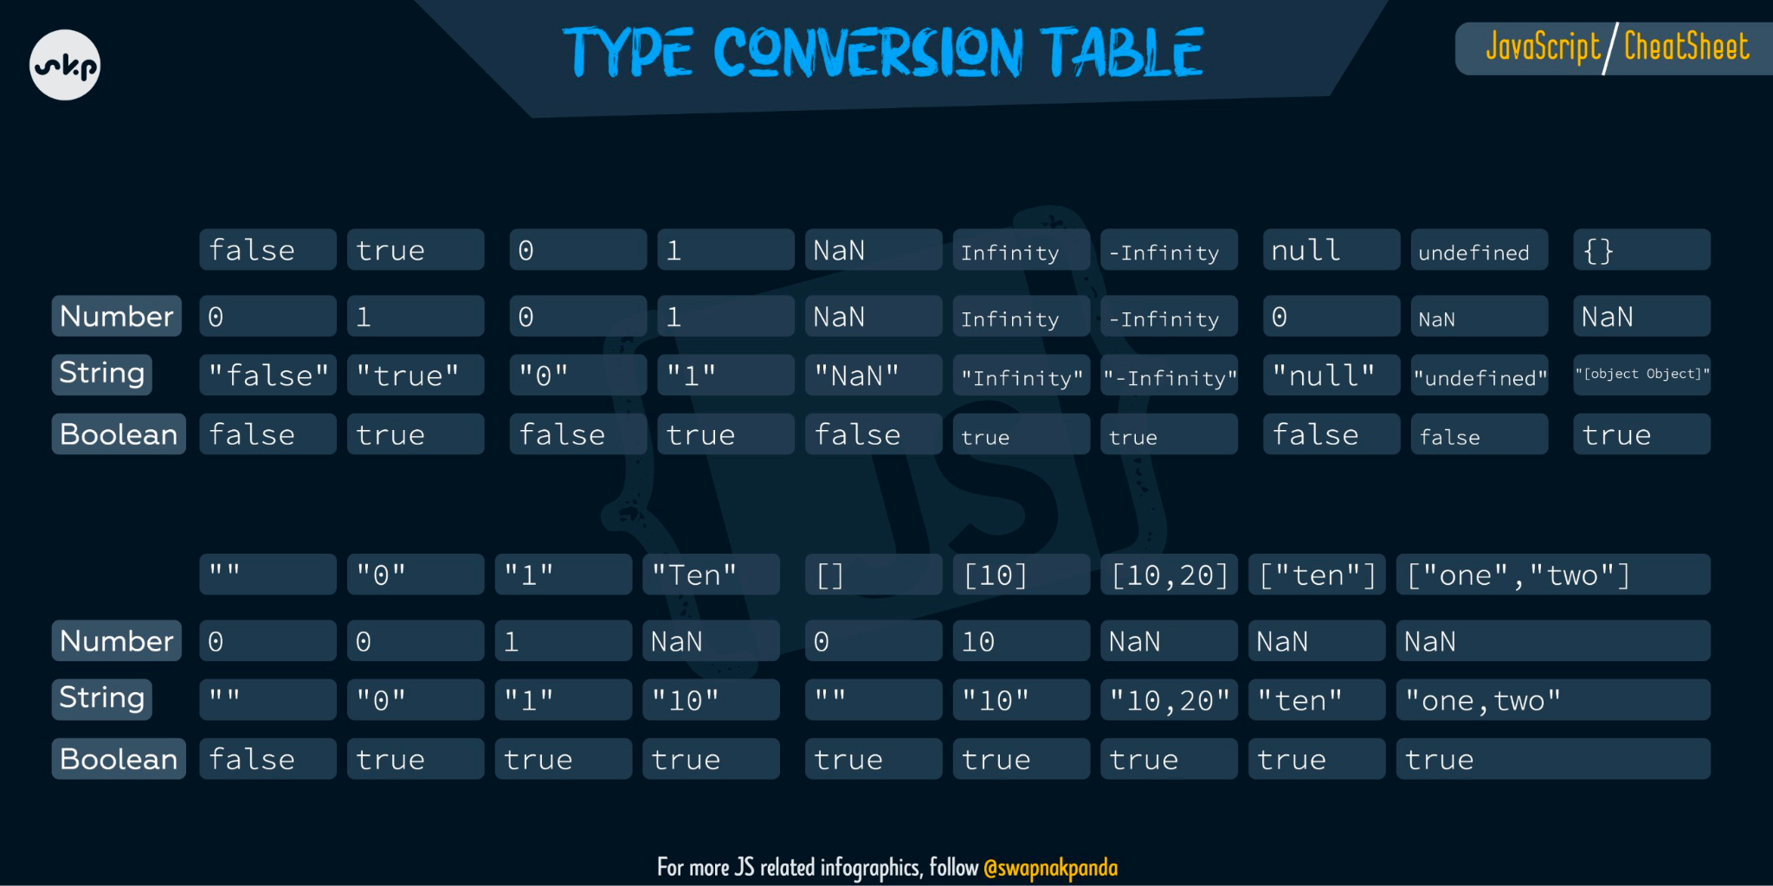
Type conversion

Slide 8
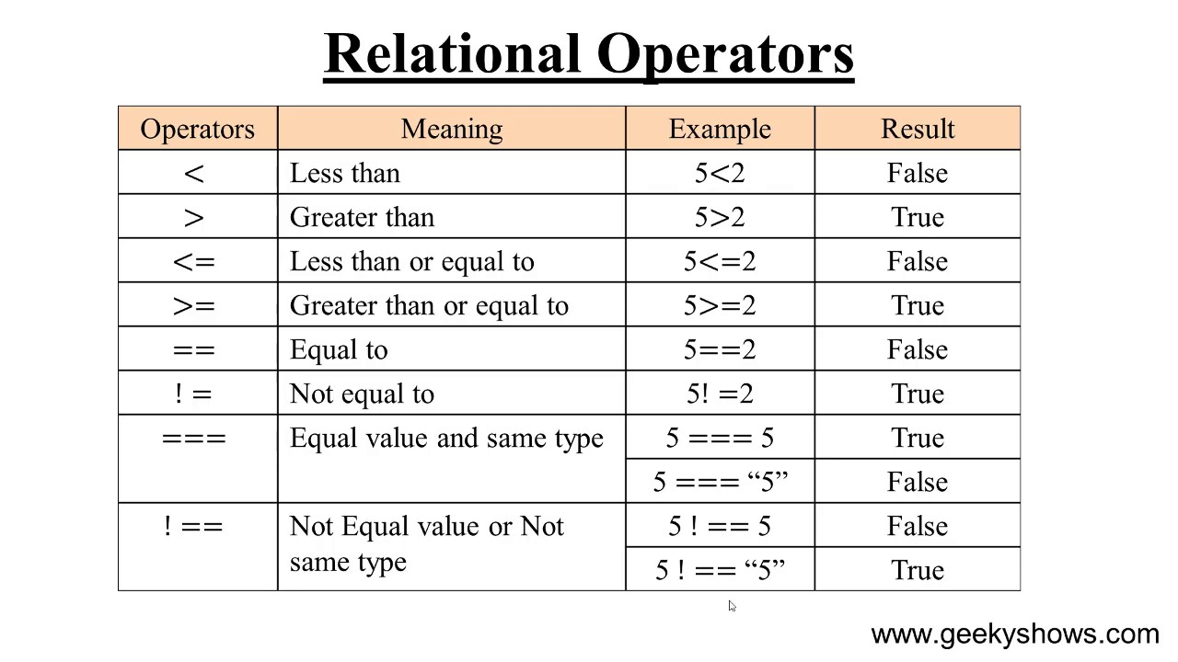
Logical operands

Slide 9
Classwork - variables
Task: Declare a variable in JavaScript called "name" and assign it the value of your first name. Then, declare a variable called "age" and assign it your current age. Finally, use console.log to print out a sentence that says "My name is [name] and I am [age] years old."
Expected Output: "My name is John and I am 30 years old."

Slide 10
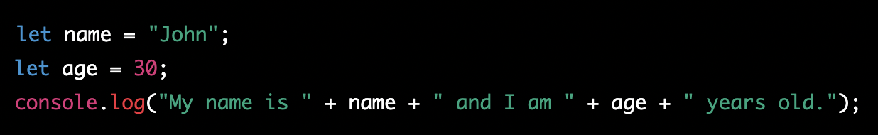
Classwork - variables (solution)

Slide 11
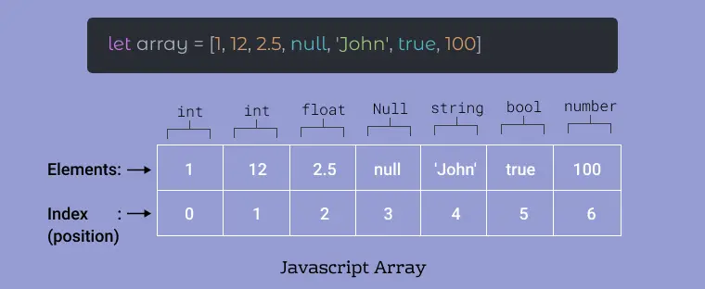
Arrays in JavaScript
JavaScript arrays and objects are both used to store collections of data.
An array is a list of values that are organized in a specific order. Each value in an array is called an element, and each element has a numerical index that can be used to access it. For example, if you have an array called "fruits" that contains the elements "apple", "banana", and "orange", you could access the "banana" element by referring to fruits[1], since it is the second element in the array (indexes start at 0).

Slide 12
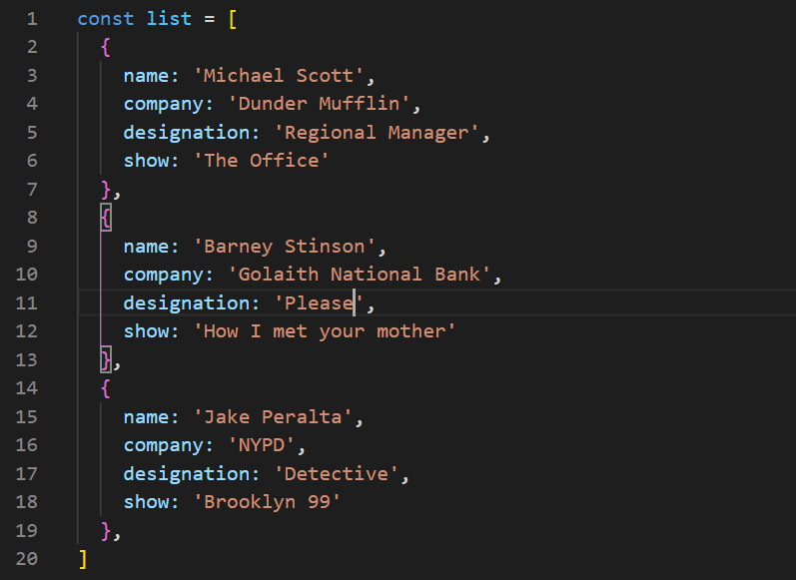
Objects in JavaScript
An object is a collection of key-value pairs, where each key is a string and each value can be any type of data. Objects are similar to arrays in that they can store collections of data, but the data is organized differently. Instead of using numerical indexes to access the data, you use the keys. For example, if you have an object called "person" that has properties like "name", "age", and "address", you could access the "name" property by referring to person.name

Slide 13
Classwork - objects
Task: Create an object, that describes you or anything else you can imaging. Object should be nested and contain another object inside.

Slide 14
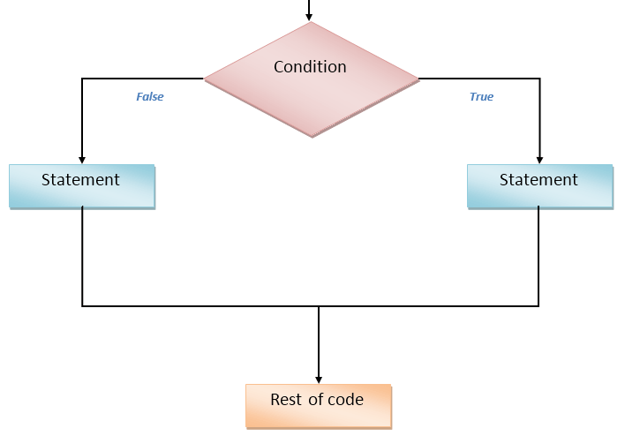
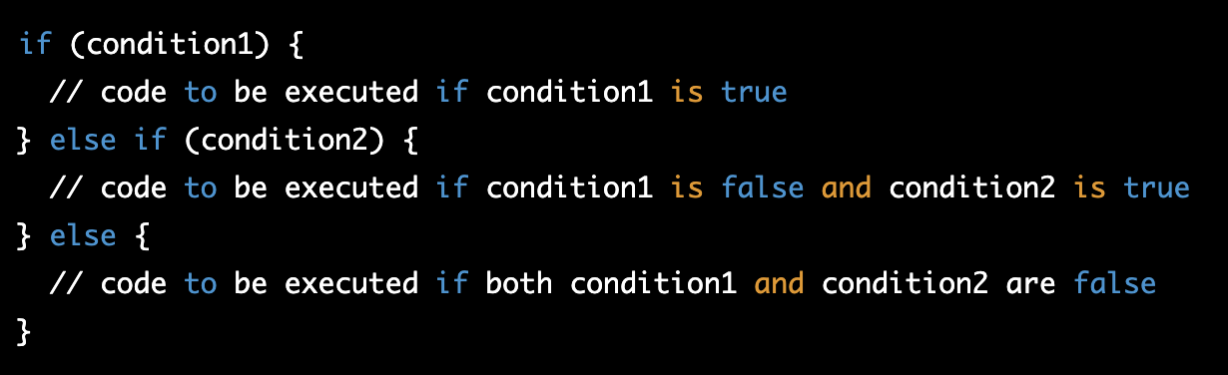
Conditional Statements (if-else)
A conditional statement in JavaScript is used to make decisions in code. It allows you to perform different actions based on different conditions. The most common type of conditional statement is the if-else statement.

Slide 15
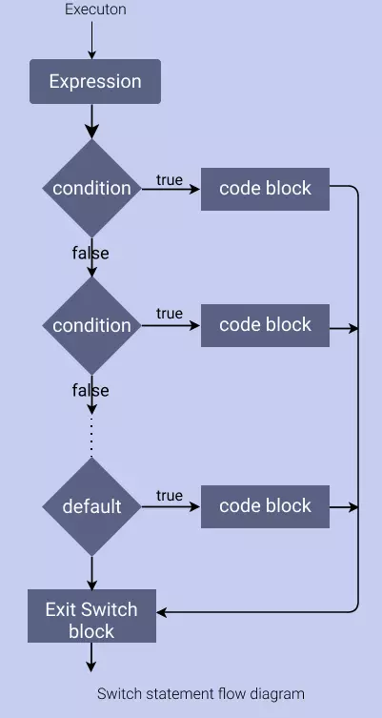
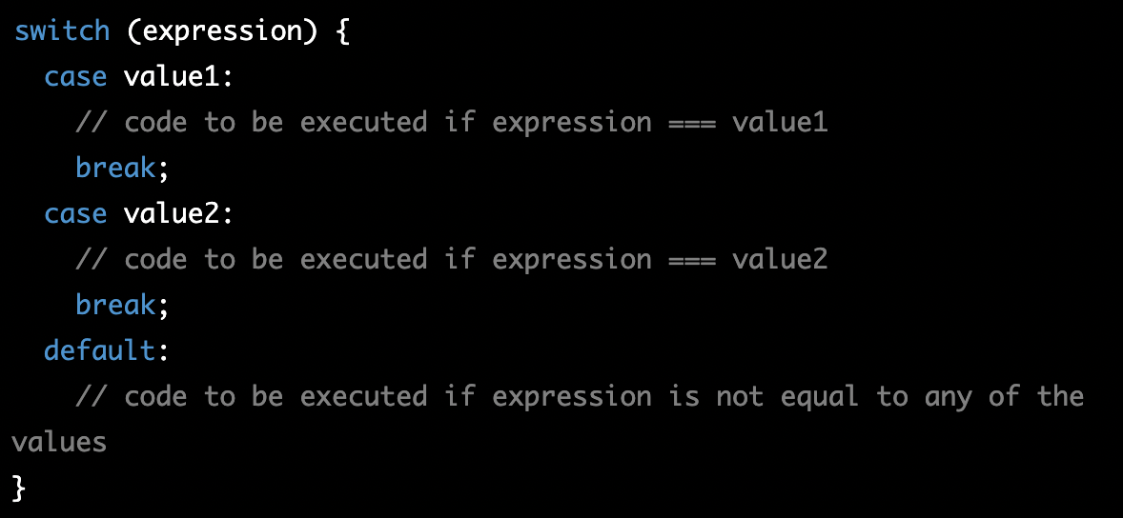
Conditional Statements (switch)
You can also use a switch statement, it's used when you want to test a value against multiple conditions:

Slide 16
Homework
Create nested object of some person/object and try reaching desired field
With if-else create traffic light logic
With switch create condition statements (using both, if and switch), that based on the variable “day” prints out day of the week
Example - if day = 5, console output = Friday

